Slide 1
Team: Team Team’s team effort for a casing management solution
Casing Tally Tinder
November 29, 2017

Slide 2
Overall Solution
Redesigned, simplified, and integrated workflow
Removes work from rig-site to a controlled, safer environment
Cheap to implement
Prevents mistakes from manually measuring and recording
Provides additional value by properly tracking individual joints of casing

Slide 3
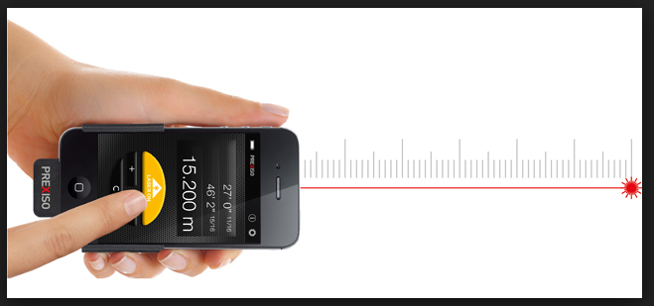
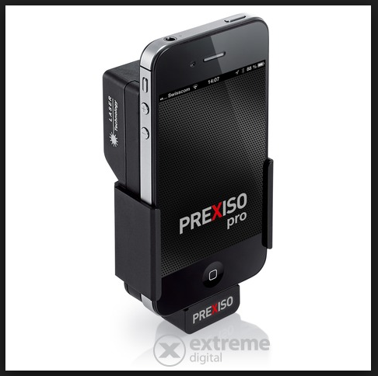
Casing vendor requirements
Laser measure each joint using any number of laser measurement tools
Create QR code containing length, casing and thread types, and additional information
Thread length can be determined by thread type and used to determine running length
Print and stick inside casing joint at pin end
Potential to tie vendor created QR codes to block chain of casing joint life cycle

Slide 4
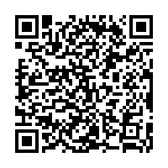
Why QR Code solution?
Everyone with a phone can read a QR code
Don’t need the application to read information
Cheaper than RFID readers
No need to manage or install devices
Printed on vinyl labels
Waterproof, durable, can be cleaned
Easily add extra information such as specifications, URLs to manuals
Generally QR code can hold 406 bytes
Audience scan this QR code now:
Length: 42.62
Type: CASING
OD: 5.50
Weight: 17
Grade: P110RY
ID: 4.892
Threat type: CDC-HTQ
Thread length: 1.23

Slide 5
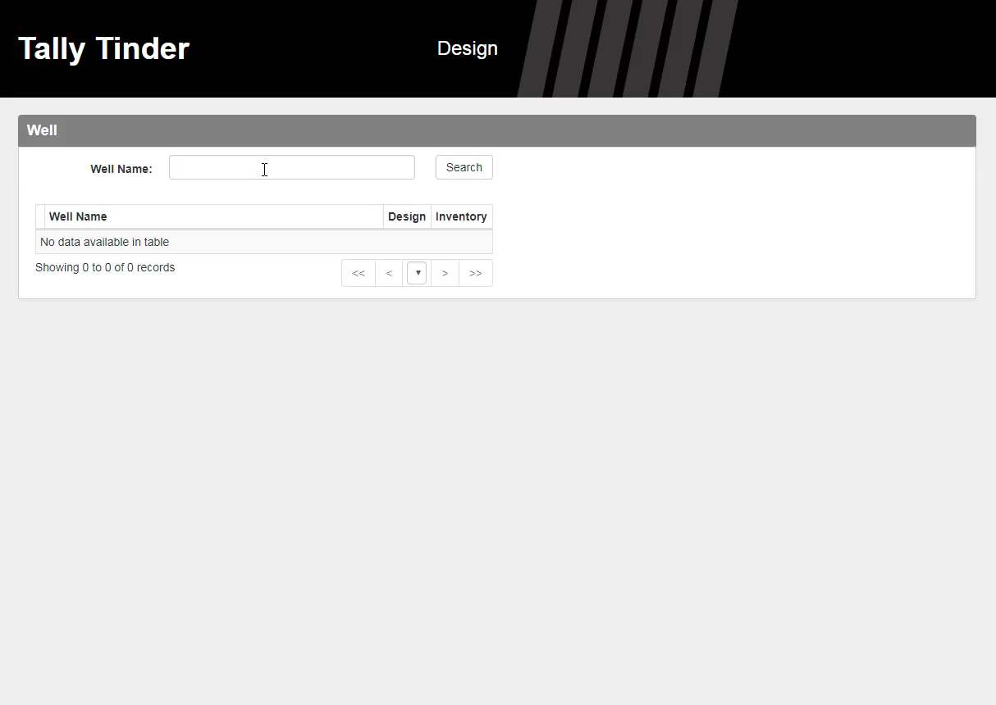
Design Tool
Engineer builds casing string design within desktop version of application
Leverage well type and model data
Obtains contextual data from WellView; target formation, critical point depths, lateral length
Design can be associated with well and stored in application to be used for:
Permit applications
Drilling Program
Procuring materials and pricing of job
Checklist on location for inventory

Slide 6
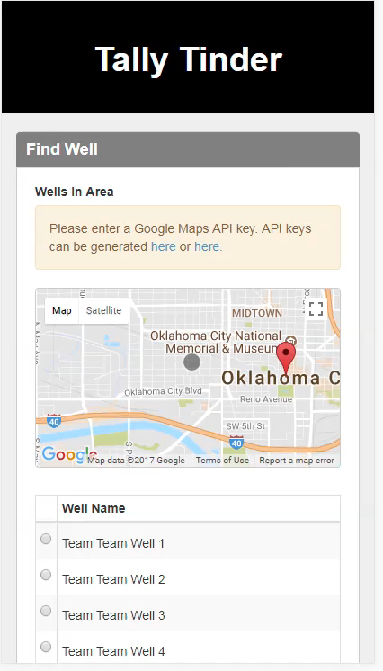
On Location
Uses GPS location to check well
Rig team select the well in the application then scan the casing which builds the inventory
Can check inventory against design
Use light on phone to scan in the dark
Caches data in application until a connection is found

Slide 7
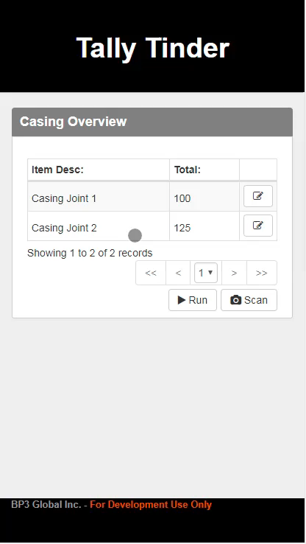
Running the casing
Swipe right as items are RIH
Swipe left for bad joint
Updates casing tally in real time
Warning when changing families, running other item or out of order
Can be used for tracking excess inventory
Track KPIs
Export and import final tally

